Slide 1
Seminar on the CWC and Chemical Safety and Security Management
Vietnam’s experience on
Storage and Transportation of
Hazardous Chemicals
Dr. Nguyen Xuan Sinh Deputy Director General of Vietnam Chemicals Agency
E-mail: Sinhnx@moit.gov.vn
Doha, February 2020

Slide 2
Content
State management of chemicals activities by life-circle (Law on Chemicals)
Hazardous Chemical Storage
Hazardous Chemical Transportation

Slide 3
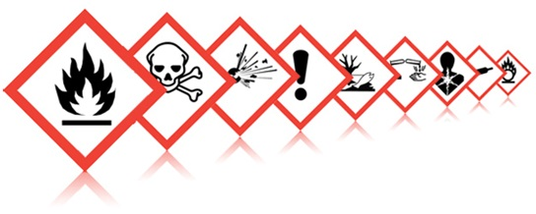
I. State management of chemicals activities by life-circle

Slide 4
Chemical Industry in Vietnam
Fertilizer
Industrial Gases
Plant protection chemical
Rubbers Products
Petrochemicals
Chemical Industry
Detergents
Basic chemicals
Pharmaceuticals
Chemical Powers
Paints and printing inks

Slide 5
Institutional framework for the chemicals management
Ministry | Import / Export | Production | Trade | Transport | Use | Disposal
Industry and Trade (MOIT) – Focal Point | ALL | ALL | ALL | - | Industrial | -
Environment and Natural Resource – MONRE | POPs, waste | - | - | POPs, waste |  | POPs, waste
Agriculture and Rural Development -MARD | Crop Protection; Agrichemicals | Crop Protection; Agrichemicals | Crop Protection; Agrichemicals | - | Crop Protection; Agrichemicals | -
Health - MOH | Pharmaceutical; biocide | Pharmaceutical; biocide | Pharmaceutical; biocide | - | Pharmaceutical; biocide | -
Transportation - MOT | - | - | - | Main | - | -

Slide 6
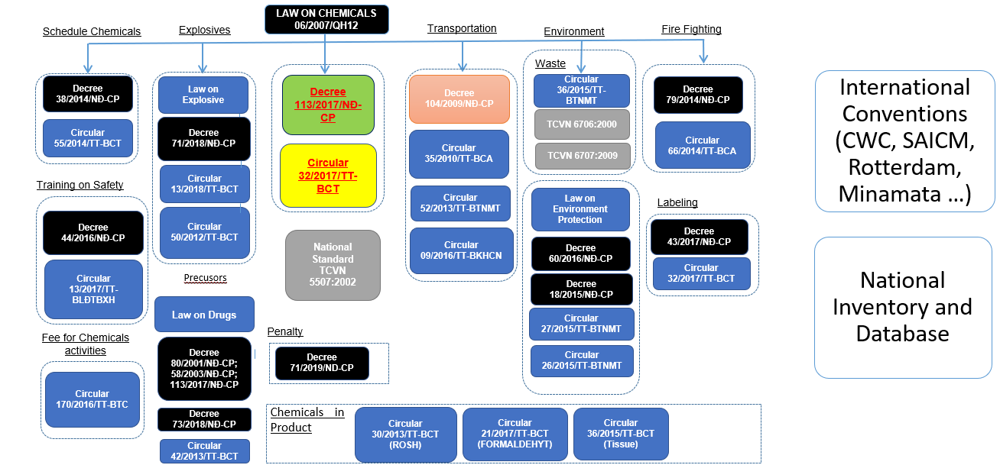
Legislation framework on chemical management

Slide 7
LAW ON CHEMICALS (List of articles relating to storage and transportation of hazardous chemicals):
Article 20.- Transport of dangerous chemicals
Article 21.- Storage and preservation of dangerous chemicals in chemical production and trading
Article 22.- Safe distance to production and trading establishments of dangerous chemicals
Article 23. Control of the purchase and sale of toxic chemicals
Article 27. Classification and labeling of chemicals
Article 28. Chemical packaging
Article 29. Chemical safety sheets
Article 34. Storage and preservation of dangerous chemicals in use
Article 36. Prevention of chemical incidents
Article 37. Equipment and forces to respond to chemical incidents
Article 43. Chemical declaration
Article 44. Registration of new chemicals
Article 47. Providing information on toxic chemicals and dangerous chemicals
Article 48. Information on new hazardous properties of chemicals
Article 66. Inspection of chemical activities

Slide 8
II. Hazardous Chemical Storage

Slide 9
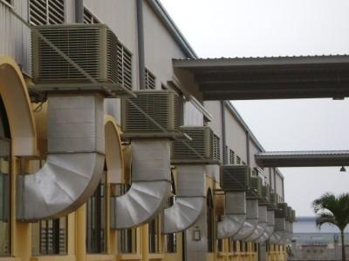
Requirement for Hazardous Chemical Storage :
Ventilation systems for factories and warehouses must follow the regulations.
Certificate of registration of environmental protection commitment
Workshops and warehouses of dangerous chemicals must be dry, impermeable leaking. Lightning systems must be periodically checked in accordance with current regulations
.
Safety monitoring equipment

Slide 10
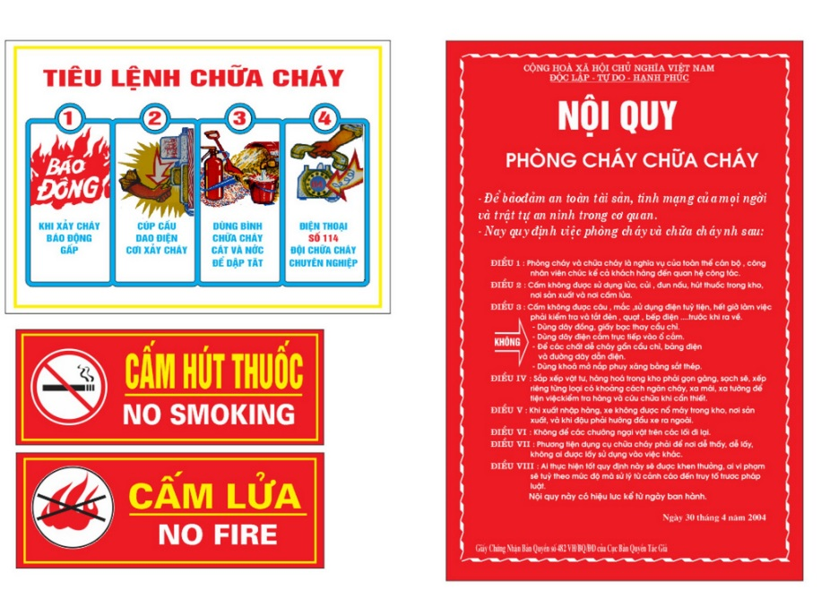
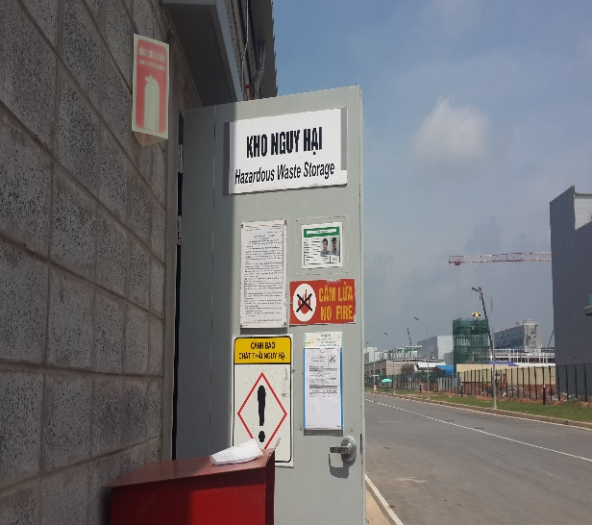
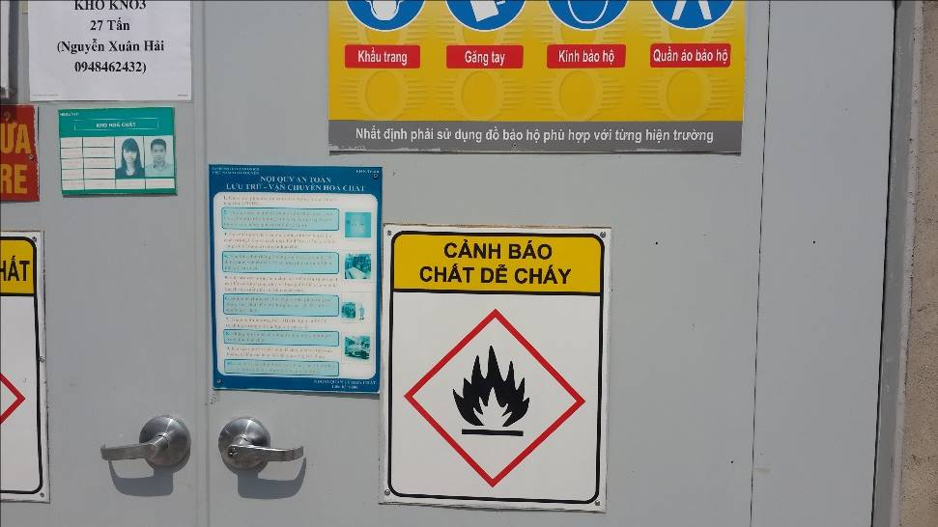
Requirement for Hazardous Chemical Storage :
Storage of industrial chemicals must include:
- A certificate of satisfaction of fire prevention and fighting conditions or a written record of assurance of fire prevention and fighting safety issued by a competent police office.
- Table of rules on chemical safety, with danger signs hanging in a noticeable place, with a signal system suitable to the level of danger and fully showing the dangerous characteristics of hazardous chemicals.

Slide 11
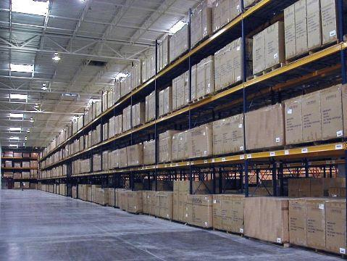
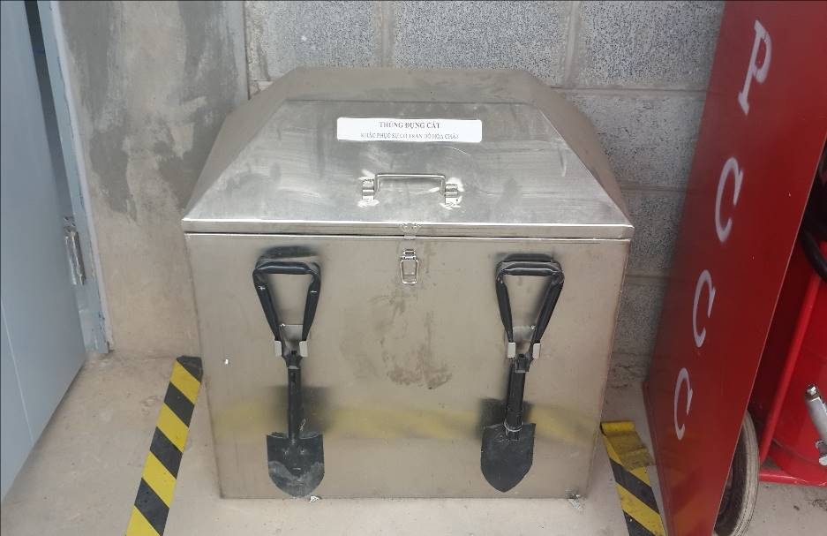
Requirement for Hazardous Chemical Storage :
1. Workshops and warehouses of hazardous chemicals must be fully equipped with personal protective equipment, suitable to the toxic level of each chemical.
2. Workers have to be trained on how to use personal protective equipment.

Slide 12
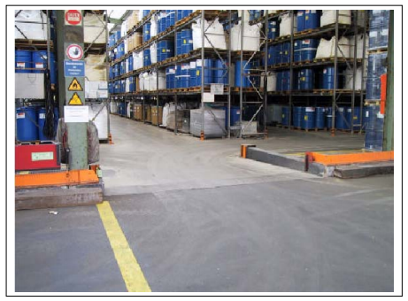
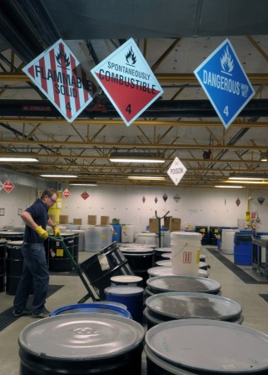
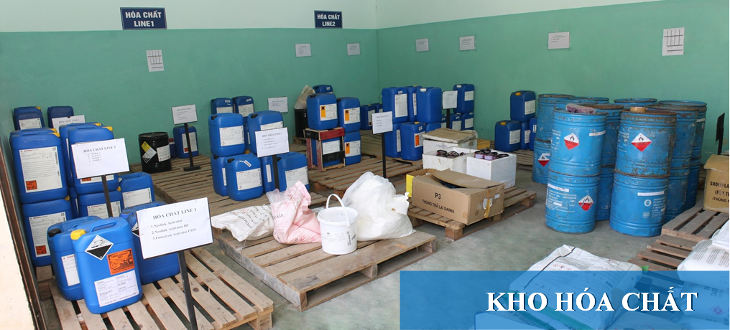
Requirement for Hazardous Chemical Storage :

Slide 13
III. Hazardous Chemical Transportation

Slide 14
Regulations on Hazardous Chemical Transportation
Decree 104/2009/NĐ-CP
Circular 25/2010/TT-BKHCN
Circular 52/2013/TT-BTNMT
Circualr 21/2015/TT-BNNPTNN
Circular 35/2010/TT-BCA
Circular 08/2012/TT-BYT

Slide 15
Authority to issue licenses to transport dangerous goods:
1. The Ministry of Public Security shall grant permits to transport dangerous goods of categories 1, 2, 3, 4 and 9
2. The Ministry of Science and Technology shall grant permits to transport dangerous goods of categories 5, 7 and 8.
3. The Ministry of Health shall grant permits to transport dangerous goods for medical chemicals and insecticidal and germicidal chemicals for domestic use.
4. The Ministry of Agriculture and Rural Development grants permits to transport dangerous goods being plant protection substances.
5. The Ministry of Natural Resources and Environment shall grant permits to transport dangerous goods for the remaining dangerous toxic chemicals in dangerous types and groups.
6. The ministries competent to grant dangerous goods transport permits mentioned in Clauses 1, 2, 3, 4 and 5 shall specify the order and procedures for granting dangerous goods transport permits.
7. Government's Decree No. 104/2009 / ND-CP of November 9, 2009, promulgating the List of dangerous goods and transporting dangerous goods by motorized road vehicles

Slide 16
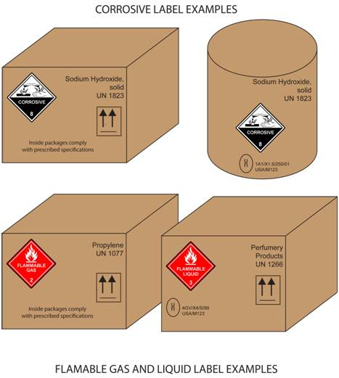
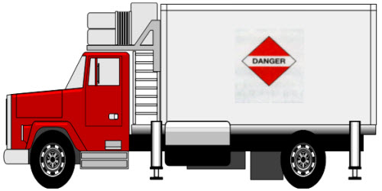
DANGEROUS GOODS PICTOGRAMS
(Appendix III of Decree No. 104/2009 / ND-CP
November 9, 2009 of the Government)

Slide 17
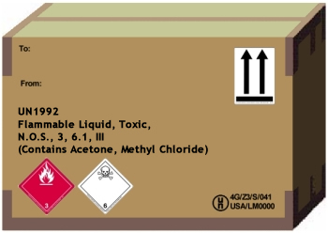
- Unify the management of classification and labeling of dangerous chemicals; chemical registration and declaration; chemical safety information;
- Circular 44/2012 / TT-BCT dated December 28, 2012 of the List of dangerous industrial goods to be packed in the process of transporting and transporting dangerous industrial goods by road motor vehicles, railway and inland waterway.

Slide 18
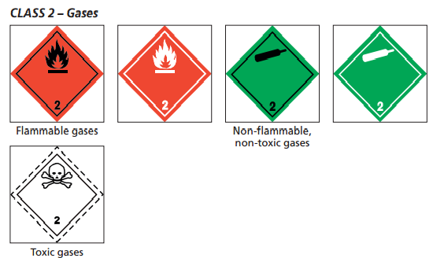
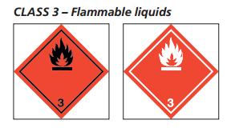
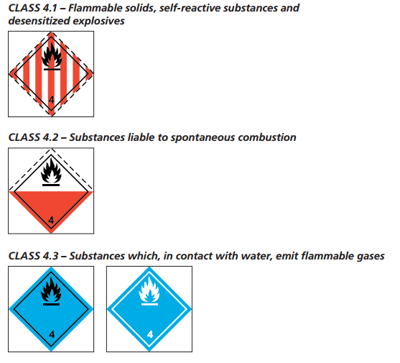
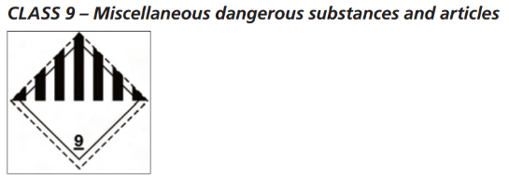
1. Circular No. 35/2010-TT-BCA stipulating the licensing of transporting industrial explosives
2. Circular No. 04/2004 / TT-BCA dated March 31, 2004 guiding the implementation of the Decree No. 35/2003 / ND-CP of April 4, 2003 detailing the implementation of a number of articles of the Law on Fire Prevention and Fighting.

Slide 19
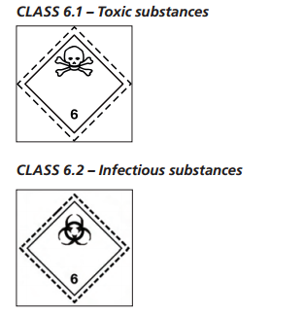
Circular 52/2013 / TT-BTNMT dated December 27, 2013 of MONRE regulating the transport of dangerous goods are toxic and infectious substances

Slide 20
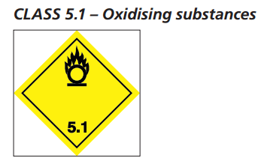
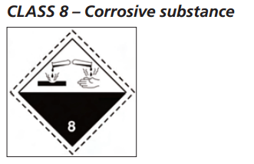
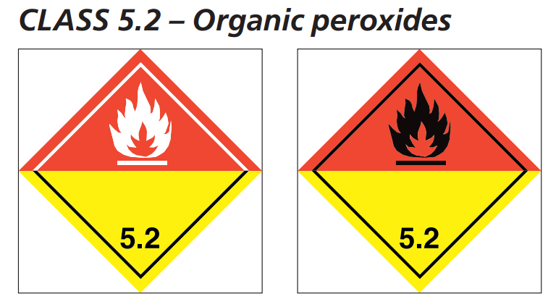
Circular No. 25/2010 / TT-BKHCN of December 29, 2010, guiding the procedures for granting permits to transport dangerous goods, which are oxidizing agents, organic oxide compounds and other corrosive substances by motorized road vehicles

Slide 21
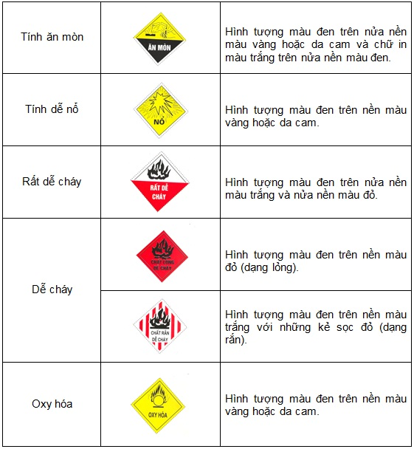
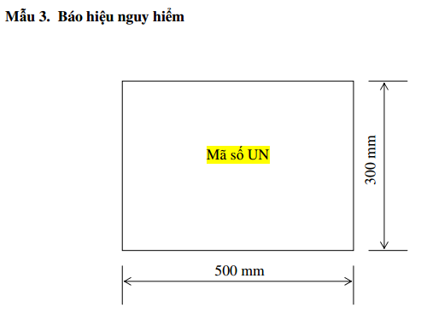
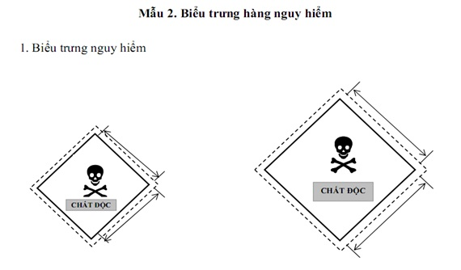
Circular No. 08/2012 / TT-BYT dated May 17, 2012 guiding the transportation of dangerous goods in the health field by motorized road vehicles

Slide 22
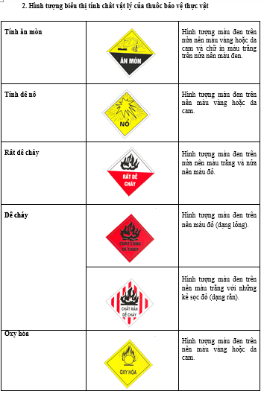
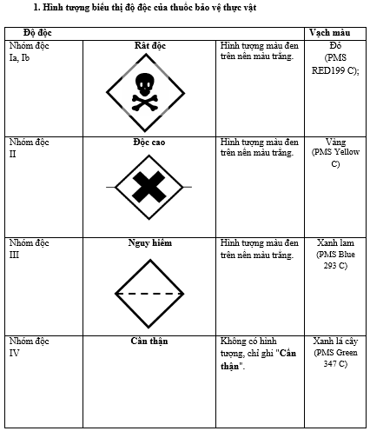
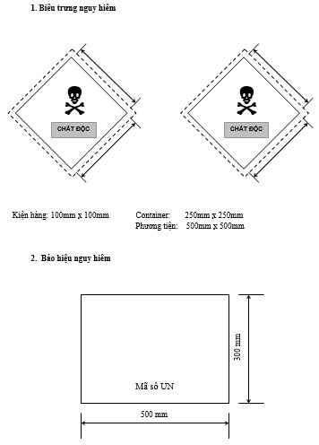
Circular No. 03/2013 / TT-BNNPTNT dated 11/1/2013 on pesticide management: registration; production, processing, bottling and packaging; import Export; trade; preservation and transportation; use; destruction; label; packaging of plant protection substances.

Slide 23
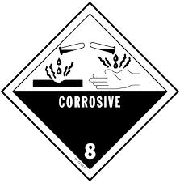
1. Promulgating regulations on transportation of dangerous chemicals by road, inland waterways, railways, aviation and maritime;
2. Developing and supplementing technical regulations on transportation of dangerous chemicals.

Slide 24
